Slide 1

Business Analysis
Athens
September 1, 2023
RDI and Business Development Business Unit, UniSystems

Slide 2
Business Analysis
What is Business Analysis?
Business analysis is the set of tasks and techniques used to work as a liaison among stakeholders in order to understand the structure, policies, and operations of an organization and to recommend solutions that enable the organization to achieve its goals.
What is the guideline for Business Analysis?
BABOK! (Business Analysis Body of Knowledge).
What is BABOK intended to?
Its intention is to describe and define business analysis as a discipline, rather than define the responsibilities of a person with the job title of business analyst.
Business analysis may be performed by people with job titles such as systems analyst, process analyst, project manager, product manager, developer, QA analyst, business architect or consultant, among others.

Slide 3

Business Analyst
Regarding to BABOK a Business Analyst’s role is to :
Analyze and synthesize information provided
Elicit the actual needs of stakeholders
Facilitate communication between organizational units
Ensure business efficiency increases through their knowledge of all units
Notes:
To babok(business analysis book of knowledge) είναι ένα framework (πλαίσιο) που περιγράφει τι είναι το business analysis και ποια tasks

Slide 4
Key Concepts
Solution :
a set of changes to the current state of an organization that are made in order to meet a business need, solve a problem, or take advantage of an opportunity.
Scope : a framework for setting expectations, determining what is included and excluded, and guiding decision-making processes.
Solution scope is typically limited and defined by the boundaries of the problem that needs to be solved.
Project scope concerns to the broader space or domain where the solution
will be utilized.
Requirements :
A condition or capability needed by a stakeholder to solve a problem or achieve an object.
A condition or capability that must be met by a solution to satisfy a contract . Standard, specification or other formally imposed documents.
A documented representation of a condition or capability (1) & (2).
A requirement may be unstated, implied by other requirements, or directly stated and managed. The elicitation, analysis, and communication of requirements, with the objective of ensuring that they are visible to and understood by all stakeholders, is central to the discipline of business analysis.

Slide 5

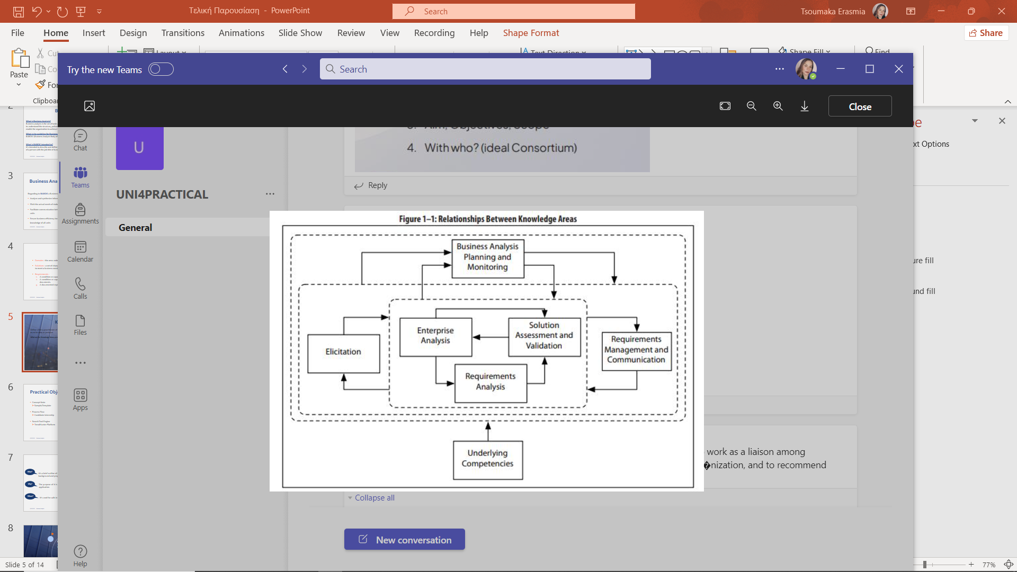
Knowledge Areas
Knowledge Areas : groups a related set of tasks and techniques.
Define what a practitioner of business analysis needs to understand and the tasks a practitioner must be able to perform.
What are the Knowledge Areas according to BABOK and what’s the relationship between them ?

Slide 6
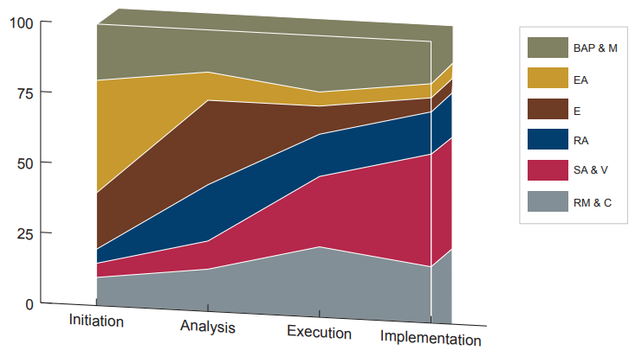
Tasks &Techniques
What’s a Task?
What’s a Technique?
Tasks are the fundamental activities that a business process analysis professional must perform during an analysis project.
As described on the below chart, tasks are not necessarily performed at a particular time in the lifecycle of a project.
Techniques provide additional information on different ways that a task may be performed or different forms the output of the task may take.
A task may have none, one, or more related techniques. A technique must be related to at least one task.

Slide 7

Practical Objectives
Concept Note
Sample/Template
Process Flow
Candidate Internship
Search Tool Engine
TrendHunter Platform

Slide 8
Concept Note
What?
It’s a brief outline of a project and it shortly involves an introduction, a background and proposed objectives.
The purpose of it is to first propose a project to a donor before submitting a full application.
It’s used for calls in Horizon Europe Work Programme.
Why?
Where?

Slide 9

Following there’s an example of a concept note that we created using the R&I Proposal Concept Template, regarding the advertisement sector:
https://www.notion.so/Concept-Note-Retail-advertisement-Mall-of-Athens-e16280de68b84da8ad50c22c2d56f7c6?pvs=4

Slide 10

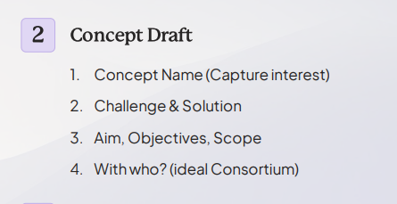
Concept Draft-Advertisement (Mall of Athens)
Solution
AI Advertisement Platform (e.g. Adpilot by Picsart)
../Desktop/2024_Trend_Report_by_Trend_Hunter.pdf
Boost Stakeholder Revenue (Retailers and Investors)
Elevated Customer Engagement
Empowered Staff with Static Insights

Slide 11
Process Flow
What’s a process flow?
Why is it used for?
A series of steps a team go through to achieve their goal
A way to visualize each subsequent step
It helps team members understand what order they have to complete tasks
Increase team’s accountability
Analyze for optimization
Standardize
Plan and document

Slide 12
Below we can see an Internship Process Flow about the candidates of the company:
Candidate Internship Process.docx

Slide 13
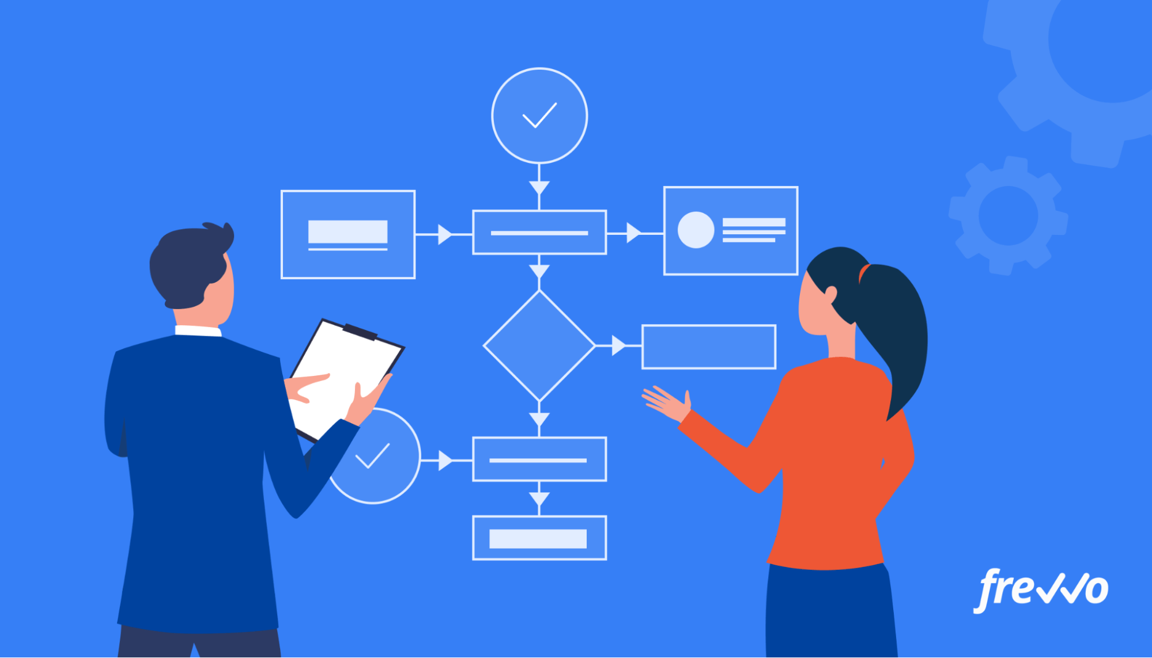
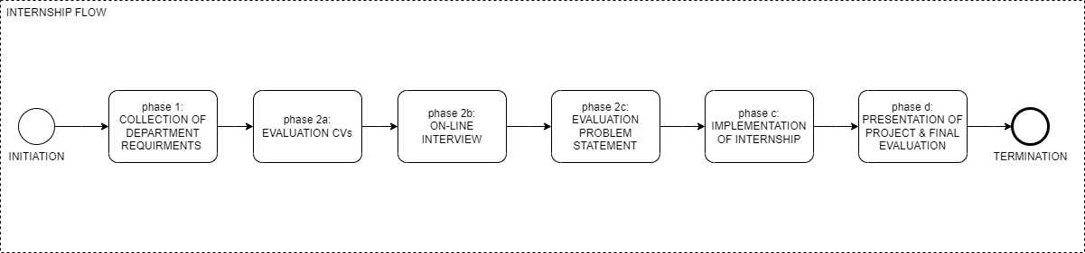
Internship Process Flow

Slide 14





TrendHunter
Identification of latest trends around the world
Popular Website
Gathering data on consumer behavior
Explore different sectors

Slide 15
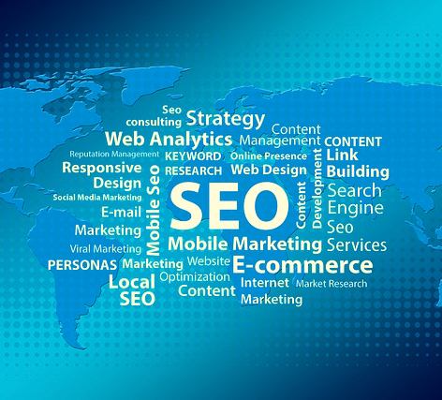
Search Tool Engines
They are software programs that help users find information.
They can be used to search the World Wide Web , a specific website, or a personal computer.
An example of a search tool that was examined by us is the platform “TrendHunter”, which will be analyzed in the next slide.

Slide 16
TrendHunter Dashboard
For navigation in the TrendHunter Dashboard follow the links below:
dashboard-walkthrough-2018.pptx (live.com)
Dashboard - Trend Hunter
Dashboard - Trend Hunter
Last but not least, in the following link we can see some general information about the platform the we collected after our search:
https://www.notion.so/Trend-Hunter-69db3e173b754785a8aaae24306732d2?pvs=4

Slide 17

Trailblazing TrendHunter
Forecasting and Comparative Tool
search engine with information sources
trends based on consumer behavior
Harmonizing Life's Hustle
information deluge
structured ideas and lists

Slide 18
Recommendations
Now
Studies at the Department of Mathematics
Business Analysis
Introduction to a Department
Certifications
Master Studies
Programming (e.g. Software Development)
Now
Near Future
Near Future

Slide 19

Thank you for your time!
We would to thank UniSystems for providing everything we needed to gain all this knowledge in Business Analysis.
Made by Filippopoulou Marina Konstantina (practical July-August) & Tsoumaka Erasmia (practical May-November).
Project Coordinator Ilias Aliferis.

